Slide 1
GENETIC ALGORITHMS
Nabh Spandan(170010008)
Deepak Das (170010012)
Anshul Sharma (170010028)

Slide 2
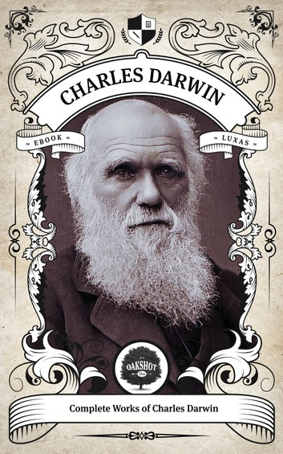
Let’s start with the famous quote by Charles Darwin:
“It is not the strongest of the species that survives, nor the most intelligent , but the one most responsive to change.”

Slide 3
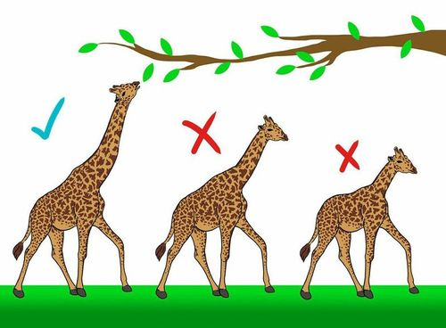
Charles Darwin’s Giraffe Theory:

Slide 4
Genetic Algorithms
Genetic Algorithms(GAs) are adaptive heuristic search algorithms that belong to the larger part of evolutionary algorithms.
Genetic algorithms are based on the ideas of natural selection and genetics.
These are intelligent exploitation of random search provided with historical data to direct the search into the region of better performance in solution space.
They are commonly used to generate high-quality solutions for optimization problems and search problems.

Slide 5
Genetic Algorithms
Genetic algorithms simulate the process of natural selection which means those species who can adapt to changes in their environment are able to survive and reproduce and go to next generation. In simple words, they simulate “survival of the fittest” among individual of consecutive generation for solving a problem. Each generation consist of a population of individuals and each individual represents a point in search space and possible solution. Each individual is represented as a string of character/integer/float/bits. This string is analogous to the Chromosome.

Slide 6
Notion Of Natural Selection
The process of natural selection starts with the selection of fittest individuals from a population.
They produce offspring which inherit the characteristics of the parents and will be added to the next generation.
If parents have better fitness, their offspring will be better than parents and have a better chance at surviving.
This process keeps on iterating and at the end, a generation with the fittest individuals will be found.
This notion can be applied for a search problem. We consider a set of solutions for a problem and select the set of best ones out of them.

Slide 7
Why use Genetic Algorithms
They are Robust.
Provide optimisation over large space state.
Unlike traditional AI, they do not break on slight change in input or presence of noise.

Slide 8
Phases Of Genetic Algorithms
Initial population.
Fitness function.
Selection.
Crossover.
Mutation.

Slide 9
Initial Population
The process begins with a set of individuals which is called a Population.
Each individual is a solution to the problem you want to solve.
Genes: An individual is characterized by a set of parameters (variables).
Genes are joined into a string to form a Chromosome (solution).

Slide 10
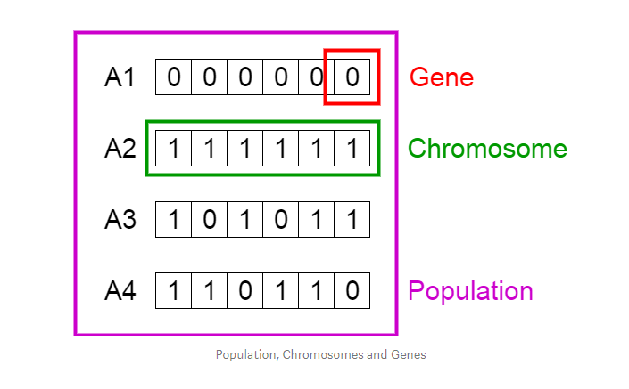
Initial Population
https://towardsdatascience.com/introduction-to-genetic-algorithms-including-example-code-e396e98d8bf3

Slide 11
Fitness Function
The fitness function determines how fit an individual is (the ability of an individual to compete with other individuals).
It gives a fitness score to each individual. The probability that an individual will be selected for reproduction is based on its fitness score.

Slide 12
Selection
The idea of selection phase is to select the fittest individuals and let them pass their genes to the next generation.
Two pairs of individuals (parents) are selected based on their fitness scores. Individuals with high fitness have more chance to be selected for reproduction.

Slide 13
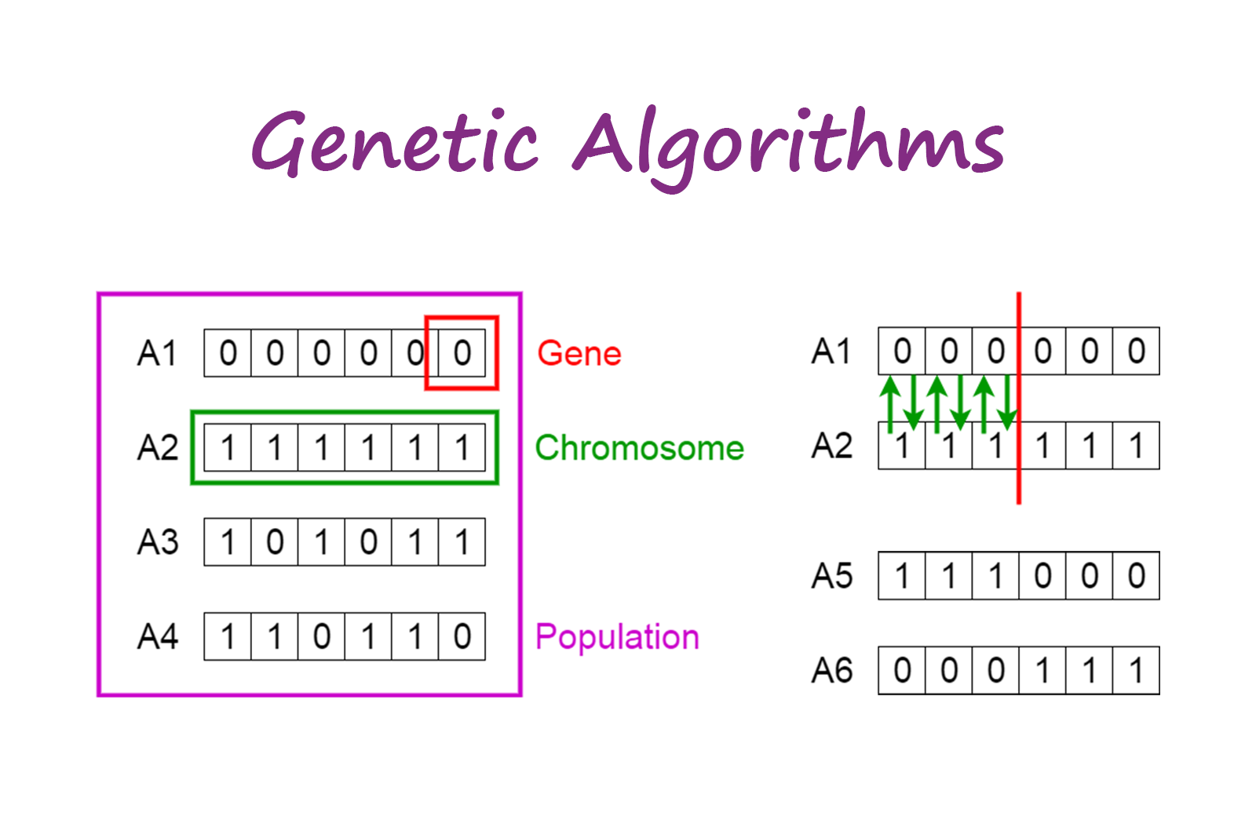
Crossover
Crossover is the most significant phase in a genetic algorithm.
For each pair of parents to be mated, a crossover point is chosen at random from within the genes.

Slide 14
Mutation
In certain new offspring formed, some of their genes can be subjected to a mutation with a low random probability.
This implies that some of the bits in the bit string can be flipped.
Mutation occurs to maintain diversity within the population and prevent premature convergence.

Slide 15
Termination
The algorithm terminates if the population has converged (does not produce offspring which are significantly different from the previous generation).
Then it is said that the genetic algorithm has provided a set of solutions to our problem.

Slide 16
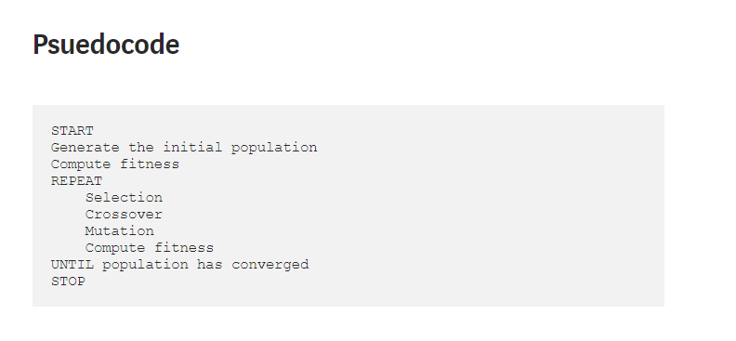
Pseudo Code for GA
https://towardsdatascience.com/introduction-to-genetic-algorithms-including-example-code-e396e98d8bf3

Slide 17

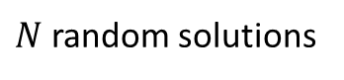
Genetic Algorithms
START
Select
$$N_{k}$$
individuals for iteration
EVALUATE THE FITNESS
$N$ random solutions
INITIAL POPULATION
SELECT MATE
CONVERGENCE
NO
YES
CROSSOVER
STOP
MUTATION

Slide 18
Convergence Test / Termination Conditions
Fixed number of generations
Budget limit reached
Solution found that satisfies objective criteria
Fittest solution becomes saturated
Fittest Fitness Value
Iterations

Slide 19
Encoding Techniques (BINARY ENCODING)
Knap-Sack Problem
Weight
Value
A
5
100
B
10
150
C
15
200
Bag Size : 25
A
AB
AC
BC
100
110
101
011

Slide 20
Fitness Evaluation: Fitness Function Or Objective Function
Weight
Value
W
P
A
5
100
A
100
5
100
B
10
150
AB
110
15
250
C
15
200
AC
101
20
300
BC
011
25
350
Bag Size : 25
ABC
111
30
400

Slide 21
Fitness Evaluation: Fitness Function Or Objective Function
9
2
5
Path Length/
Fitness Value
Path
4
6
12
Path: 1
1 2 5 6 4 3 1
44
2
Path: 2
1 2 5 4 6 3 1
1
4
8
51
Path: 3
45
1 2 4 5 6 3 1
Path: 4
40
5
7
11
1 2 5 6 3 4 1
3
6
10

Slide 22
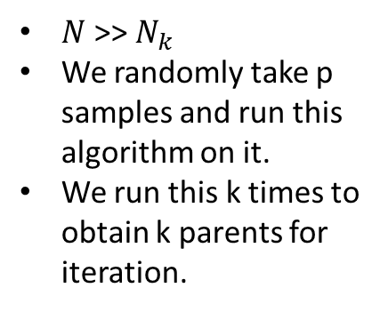
Tournament Selection Method
$N$>> $N_{k}$
We randomly take p samples and run this algorithm on it.
We run this k times to obtain k parents for iteration.
G
A
G
A
C
F
G
A
B
C
D
E
F
G
H
9
8
6
2
4
7
11
3

Slide 23
Roulette Selection Method
$N$>> $N_{k}$
We randomly take p samples and run this algorithm on it.
We run this k times to obtain k parents for iteration.
Fitness
%
A
5
50
B
2
20
C
0.5
5
D
1.5
15
E
1
10
10
% value of a node = Fitness value of the node * 100
(Sum of fitness value of all p nodes)

Slide 24
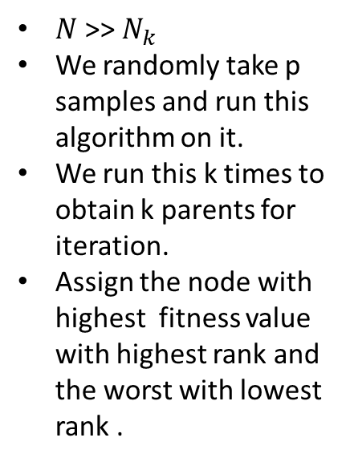
Rank Selection Method
$N$>> $N_{k}$
We randomly take p samples and run this algorithm on it.
We run this k times to obtain k parents for iteration.
Assign the node with highest fitness value with highest rank and the worst with lowest rank .
Fitness
Rank
%
A
5
5
33.33
B
2
4
26.67
C
0.5
1
6.67
D
1.5
3
20
E
1
2
13.33
10
% value of a node = Rank of the node * 100
(Sum of fitness ranks of all p nodes)

Slide 25
Crossover
Single point crossover
Two point crossover
Multiple point crossover

Slide 26
Single Point Crossover
P1
0
1
1
0
1
0
P2
1
1
0
1
0
0
O1
0
1
0
1
0
0
O2
1
1
1
0
1
0

Slide 27
Two Point Crossover
P1
0
1
1
0
1
0
P2
1
1
0
1
0
0
O1
0
1
0
1
1
0
O2
1
1
1
0
0
0

Slide 28
Multi Point Crossover
P1
0
1
1
0
1
0
P2
1
1
0
1
0
0
O1
0
1
1
0
0
0
O2
1
1
0
1
1
0

Slide 29
Multi Point Crossover
P1
0
0
1
0
1
1
P2
1
0
0
1
0
0
Toss
1
0
0
1
1
0
O1
1
0
1
1
0
1
O2
0
0
0
0
1
0

Slide 30
Mutation : Mutation Probability
o
0
1
1
0
0
1
mp
0
1
0
0
0
1
mo
0
0
1
0
0
0

Slide 31
Mutation : Interchange
Select two random bits and interchange them
o
0
1
1
0
0
1
mo
1
1
0
0
0
1

Slide 32
Application of Genetic Algorithms
Recurrent Neural Network
Mutation testing
Code breaking
Filtering and signal processing
Learning fuzzy rule base etc

Slide 33
Genetic Algorithm : Monkey Problem
Brute Force Search :
To type a phrase let say :
“to be or not to be that is the question”
So total 39 characters from the set of 27 different characters
So the likelihood of typing whole phrase is (1/27)^39
That means 1 in 66,555,937,033,867,822,607,895,549,241,096,482,953,017,615,834,735,226,163

Slide 34
Continued:
A Computer simulation with 1 million phrases per sec would take 9,719,096,182,010,563,073,125,591,133,903,305,625,605,017 years
Age of universe: 13,750,000,000 years (estimated).
Other example where genetic algo is used is in BOXCAR 2D
A genetic algorithm continuously generates new vehicles based on the one that traveled the farthest ( link )

Slide 35
NP-hard Problems
There are many tasks for which we know fast (polynomial) algorithms. There are also some problems that are not possible to be solved algorithmically. For some problems was proved that they are not solvable in polynomial time.
But there are many important tasks, for which it is very difficult to find a solution, but once we have it, it is easy to check the solution. This fact led to NP-complete problems. NP stands for nondeterministic polynomial and it means that it is possible to "guess" the solution (by some nondeterministic algorithm) and then check it, both in polynomial time. If we had a machine that can guess, we would be able to find a solution in some reasonable time.

Slide 36
Studying of NP-complete problems is for simplicity restricted to the problems, where the answer can be yes or no. Because there are tasks with complicated outputs, a class of problems called NP-hard problems has been introduced. This class is not as limited as class of NP-complete problems.
For NP-problems is characteristic that some simple algorithm to find a solution is obvious at a first sight - just trying all possible solutions. But this algorithm is very slow (usually O(2^n)) and even for a bit bigger instances of the problems it is not usable at all.
Today nobody knows if some faster exact algorithm exists. Proving or disproving this remains as a big task for new researchers (and maybe you! :-)). Today many people think, that such an algorithm does not exist and so they are looking for some alternative methods - example of these methods are genetic algorithms.
Examples of the NP problems are satisfiability problem, travelling salesman problem or knapsack problem.

Slide 37
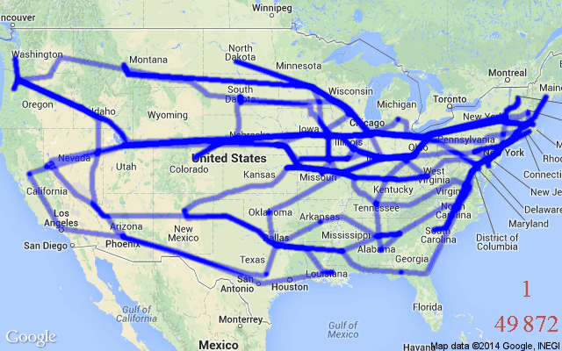
Travelling Salesman Problem
There are cities and given distances between them.Travelling salesman has to visit all of them, but he does not to travel very much. Task is to find a sequence of cities to minimize travelled distance. In other words, find a minimal Hamiltonian tour in a complete graph of N nodes.
This is a famous problem and has been efficiently adopted by many sales-based companies as it is time saving and economical. This is also achieved using genetic algorithm.
source

Slide 38
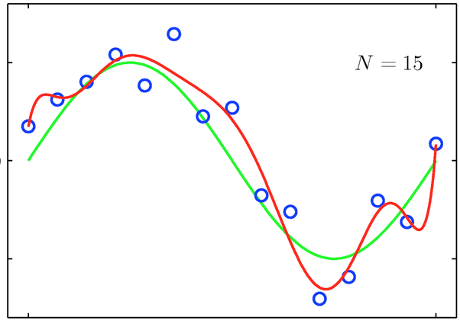
How about curve fitting?
Generate some random data points, then evolve the coefficients for an Nth order polynomial to minimise the mean squared error
source

Slide 39
Other examples are
Galactic Arms Race (game even available on steam)
Learning robot behavior using genetic algorithms
Groundwater monitoring network
Neural Networks ; particularly recurrent neural networks

Slide 40
Question 1:
Consider the problem of ﬁnding the shortest route through several cities, such that each city is visited only once and in the end return to the starting city (the Travelling Salesman problem). Suppose that in order to solve this problem we use a genetic algorithm, in which genes represent links between pairs of cities. For example, a link between London and Paris is represented by a single gene ‘LP’. Let also assume that the direction in which we travel is not important, so that LP = PL.
How many genes will be used in a chromosome of each individual if the number of cities is 10?
How many genes will be in the alphabet of the algorithm?

Slide 41
Question 2
Suppose a genetic algorithm uses chromosomes of the form x = abcdefgh with a ﬁxed length of eight genes. Each gene can be any digit between 0 and 9. Let the ﬁtness of individual x be calculated as: f(x) = (a+ b)−(c + d)+(e+ f)−(g + h) , and let the initial population consist of four individuals with the following chromosomes:
x1 = 65413532 , x2 = 87126601 , x3 = 23921285 , x4 = 41852094
a) Evaluate the ﬁtness of each individual, showing all your workings, and arrange them in order with the ﬁttest ﬁrst and the least ﬁt last.
b) Perform the following crossover operations:
i) Cross the ﬁttest two individuals using one–point crossover at the middle point.
ii) Cross the second and third ﬁttest individuals using a two–point crossover (points b and f).
iii) Cross the ﬁrst and third ﬁttest individuals (ranked 1st and 3rd) using a uniform crossover.
c) Suppose the new population consists of the six oﬀspring individuals received by the crossover operations in the above question. Evaluate the ﬁtness of the new population, showing all your workings. Has the overall ﬁtness improved?

Slide 42
Answer 1:
Each chromosome will consist of 10 genes. Each gene representing the path between a pair of cities in the tour.
The alphabet will consist of 45 genes. Indeed, each of the 10 cities can be connected with 9 remaining. Thus, 10×9 = 90 is the number of ways in which 10 cities can be grouped in pairs. However, because the direction is not important (i.e. London–Paris is the same as Paris–London) the number must be divided by 2. So, we shall need 90/2 = 45 genes in order to encode all pairs. In general the formula for n cities is: n(n−1)/2

Slide 43
Answer 2:
f(x1) = (6+5)−(4+1)+(3+5)−(3+2) = 9
f(x2) = (8+7)−(1+2)+(6+6)−(0+1) = 23
f(x3) = (2+3)−(9+2)+(1+2)−(8+5) =−16
f(x4) = (4+1)−(8+5)+(2+0)−(9+4) =−19
The order is x2, x1, x3 and x4.
b) i) One–point crossover on x2 and x1:
x2 = 8712 | 6601 O1 = 87123532
x1 = 6541 | 3532 O2 = 65416601
ii) Two–point crossover on x1 and x3:
x1 = 65 | 4135 | 32 O3 = 65921232
x3 = 23 | 9212 | 85 O4 = 23413585

Slide 44
Answer 2:
iii) In the simplest case uniform crossover means just a random exchange of genes between two parents. For example, we may swap genes at positions a, d and f of parents x2 and x3:
x2 = 87126601 O5 = 27126201
x3 = 23921285 O6 = 83921685
c) The new population is:
O1 = 87123532
O2 = 65416601
O3 = 65921232
O4 = 23413585
O5 = 27126201
O6 = 83921685

Slide 45
Answer 2:
Now apply the ﬁtness function f(x) = (a+b)−(c+d)+(e+f)−(g+h):
f(O1) = (8+7)−(1+2)+(3+5)−(3+2) = 15
f(O2) = (6+5)−(4+1)+(6+6)−(0+1) = 17
f(O3) = (6+5)−(9+2)+(1+2)−(3+2) =−2
f(O4) = (2+3)−(4+1)+(3+5)−(8+5) =−5
f(O5) = (2+7)−(1+2)+(6+2)−(0+1) = 13
f(O6) = (8+3)−(9+2)+(1+6)−(8+5) =−6

Slide 46
References
https://www.analyticsvidhya.com/blog/2017/07/introduction-to-genetic-algorithm/
https://www.quora.com/What-is-an-easy-problem-solvable-using-genetic-algorithms
GeeksforGeeks (https://www.geeksforgeeks.org/genetic-algorithms/)
The Coding Train (Youtube link)
Wiki

